Slide 1

Supportive Technology – Technology First
Assistive Technology and
Remote Supports & Monitoring
2025

Slide 2

Technology
Forward Initiative
Through the Technology Forward Initiative, Massachusetts DDS has developed an initiative to promote the use of Supportive Technology to increase the opportunities for individuals to achieve greater independence in their lives.

Slide 3
Barriers to AT in I/DD
Policy
Funding
Lack of Access to Assessment
Unawareness/Lack of training
Understudied Population/Subject
Notes:
*There is a major gap in access to tech in general for people w IDD.
While life is increasingly more dependent people with intellectual and developmental disabilities. This creates a gap in access to vocational, social opportunities.
Exascerbated in adult setting…….
Go through barriers
Policy – AT is afterthought
Funding– hard to navigate and expensive
Lack of Access to Assessment
Unawareness/Lack of training– among support providers
Understudied—lack of research
Sarah just pointed to some of the needs of the people we serve.
For those those who require 24/7 support often have even more limited access.
Less opportunity for self-advocacy. And there is often over-support by staff.
Sustaining is often more difficult because of staffing, changing staffing, lack of buy-in, and training
To complicate this: Projected 125% quickly increasing population in need of services and major staffing issues and the need for AT is significant
The good news is there is cheaper mainstream tech

Slide 4
Need
Gap in access to technology leading to barriers in:
Community access
Vocational opportunities
Social participation
Significant health inequities
Higher mortality rate from preventable diseases
Communication difficulties

Slide 5
Addressing Barriers to AT Access
Barrier
Approach
Device mismatch
Lack of buy-in
Roles are unclear
Funding
Team is underprepared/lacks training
Maintenance
Understudied
Person-centered assessment
Team-based assessment
Frameworks
Tiered Model
Training/Resources
Ongoing supports
Outcome surveys and research

Slide 6
What do we mean when we say
Technology Forward?
Massachusetts is one of the first states to embrace the Technology Forward Initiative for individuals served by Dept of Developmental Services through Supportive Technology initiative
Supportive Technology allows the use of assistive technology to increase the opportunities for individuals to achieve greater independence and function in their lives
Supportive Technology should be considered when authorizing services for a person with a disability before utilizing direct, professional support services to assist a person in an area that they could potentially be self-sufficient with appropriate assistive technology.

Slide 7
DDS AT Program = Facilitators
Policy: DDS created a program that addresses thes policy barriers.
Funding: Waiver service addresses Insurance funding gap
Lack of Access to Assessment: 12 agencies with expert providers.
Unawareness/Lack of training: Team based assessment and built-in training hours for whole team
Understudied Population/Subject: Innovation grants offer opportunity for studies
Notes:
*There is a major gap in access to tech in general for people w IDD.
While life is increasingly more dependent people with intellectual and developmental disabilities. This creates a gap in access to vocational, social opportunities.
Exascerbated in adult setting…….
Go through barriers
Policy – AT is afterthought
Funding– hard to navigate and expensive
Lack of Access to Assessment
Unawareness/Lack of training– among support providers
Understudied—lack of research
Sarah just pointed to some of the needs of the people we serve.
For those those who require 24/7 support often have even more limited access.
Less opportunity for self-advocacy. And there is often over-support by staff.
Sustaining is often more difficult because of staffing, changing staffing, lack of buy-in, and training
To complicate this: Projected 125% quickly increasing population in need of services and major staffing issues and the need for AT is significant
The good news is there is cheaper mainstream tech

Slide 8
DDS Tech Forward Initiative
2018: ARC of MA Innovation and Technology Task Force
April 2021: DDS launched the initiative.
  Address the gap in technology access for people with developmental disabilities
  Increase access to AT
  Address chronic staff shortages
  Increase functional independence for individuals
  Shifts thinking to Tech Forward****Supportive Technology should be considered as a primary service for all adults.

Slide 9
What is Assistive Technology
Assistive Technology (AT) According to ATIA: AT is any item, piece of equipment, software program, or product system that is used to increase, maintain or improve the functional capabilities of persons with disabilities.
AT can be no tech, low tech, or high tech.
AT can improve daily function based on a domain area of focus, including the use of Remote Supports and Monitoring (RSM) when appropriate

Slide 10
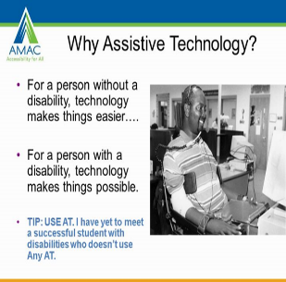
Why Assistive Technology?

Slide 11
Supportive Technology at DDS
3 Areas under Supportive Technology
Assistive Technology (AT) Assessments & Services
Remote Supports and Monitoring (RSM)
Assistive Technology Centers (ATC)

Slide 12
Assistive Technology Services involve 3 distinct components
Assistive Technology consultation/evaluation – The individual is referred by their Service Coordinator to engage in an assessment of need by a qualified AT Provider of their choice. Needs focus on domain areas where functional improvements can be made with AT.
Assistive Technology devices - The cost of assistive technology equipment or devices (e.g. door alarm, stove sensors) purchased per the AT evaluation and the related goals. Various funding options are explored, including DDS.​
Assistive technology training/support - This is the set-up of AT equipment, education and training how to use the assistive technology, as well as training for the individual's support network (paid/unpaid) or who are otherwise substantially involved in activities being supported by the assistive technology equipment.

Slide 13

AT assessment is a collaborative process, not just a one-time event by a specialist
Collaborative Process between multi-disciplinary team
Unique perspective of each person where they support the person (home, day, work)
AT Provider gathers information and addresses the area where AT may increase function and independence
Set up and training occurs for the individual and the support members of the team

Slide 14
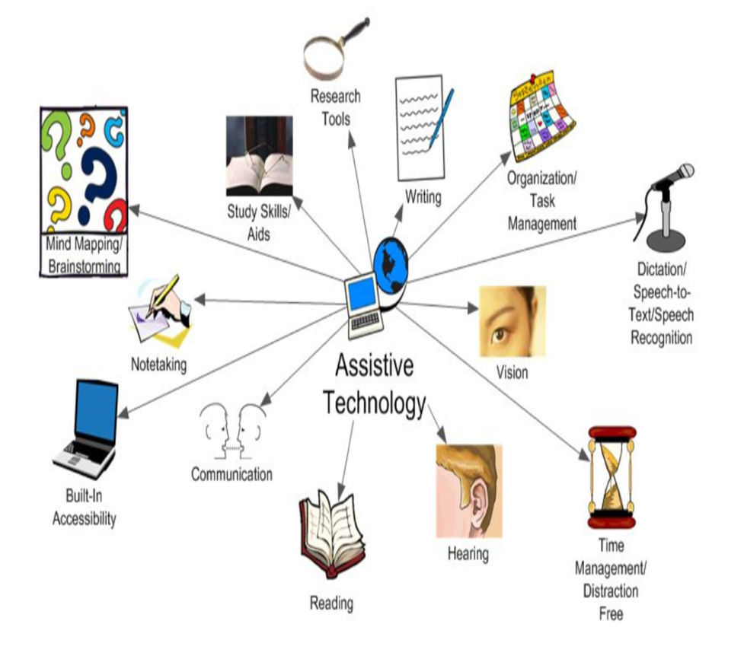
AT Domains
  Vision
  Hearing & Listening
  Communication access
  Technology access
  Environmental Access
  Hygiene
  Daily living
  Safety
  Learning and cognition
  Employment
  Organization and executive function
  Community safety and memory
  Leisure and recreation

Slide 15
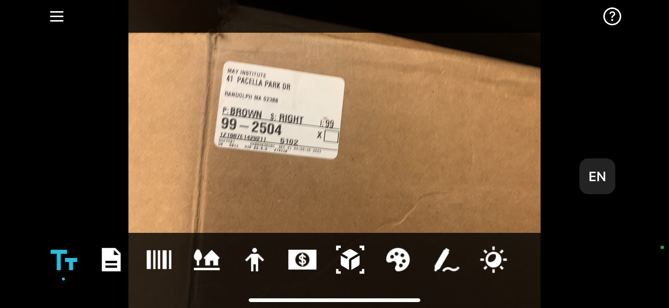
Literacy
Speech to text/text to speech apps
Laser readers
Google Accessibility
AI-based apps
  Grammar
  Social language

Slide 16
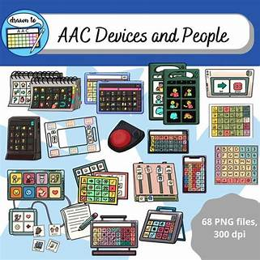

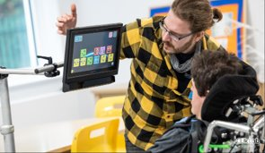
Communication

Slide 17

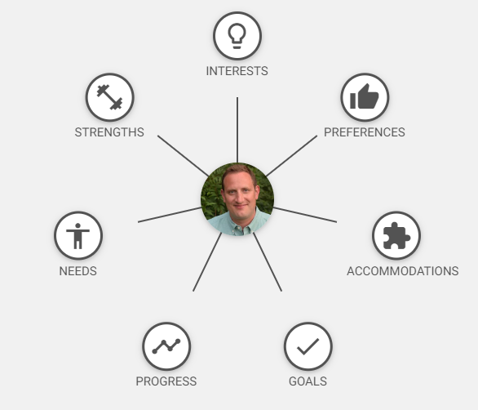
Vocational/Educational/
Life Planning/Organization
COGNATOPIA
Scheduling apps
Goal setting apps
Executive Functioning
Predictive AI/voice recognition
Establish routines and use of QR codes to support caregivers and individuals alike for consistent learning.

Slide 18
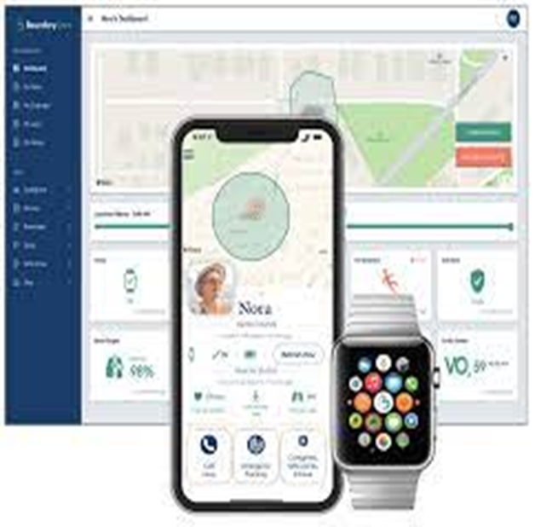
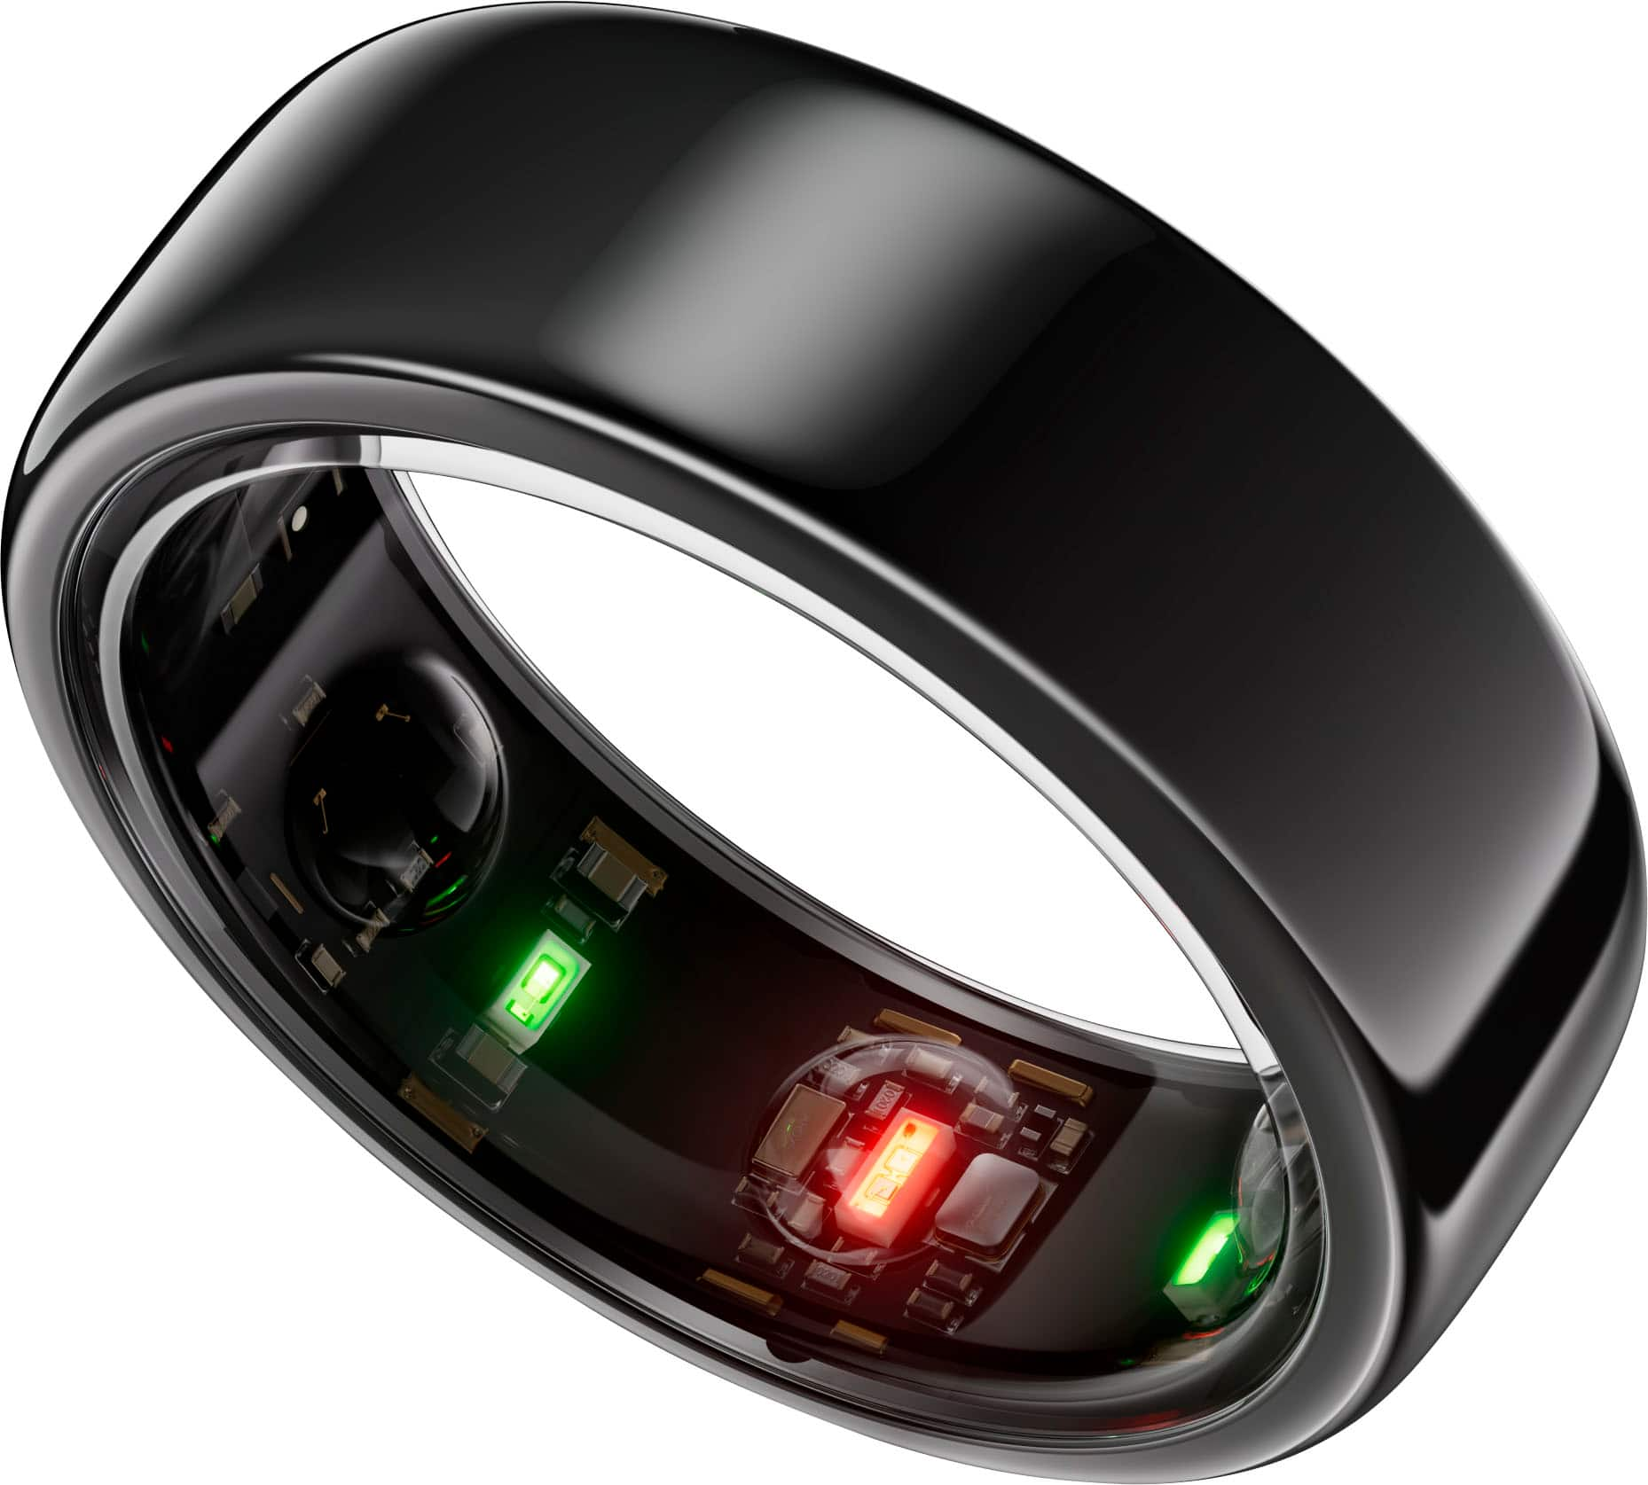
Health/Medical/Biometrics
Wearable/Environmental
Blood pressure
Oxygen saturation
Breathing rate
Fall alert
Seizures
Increased exercise
Mental health

Slide 19
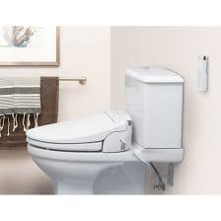
Hygiene
Soap dispensers
Shower speakers
Temperature gauges
Bidets
Body dryers

Slide 20
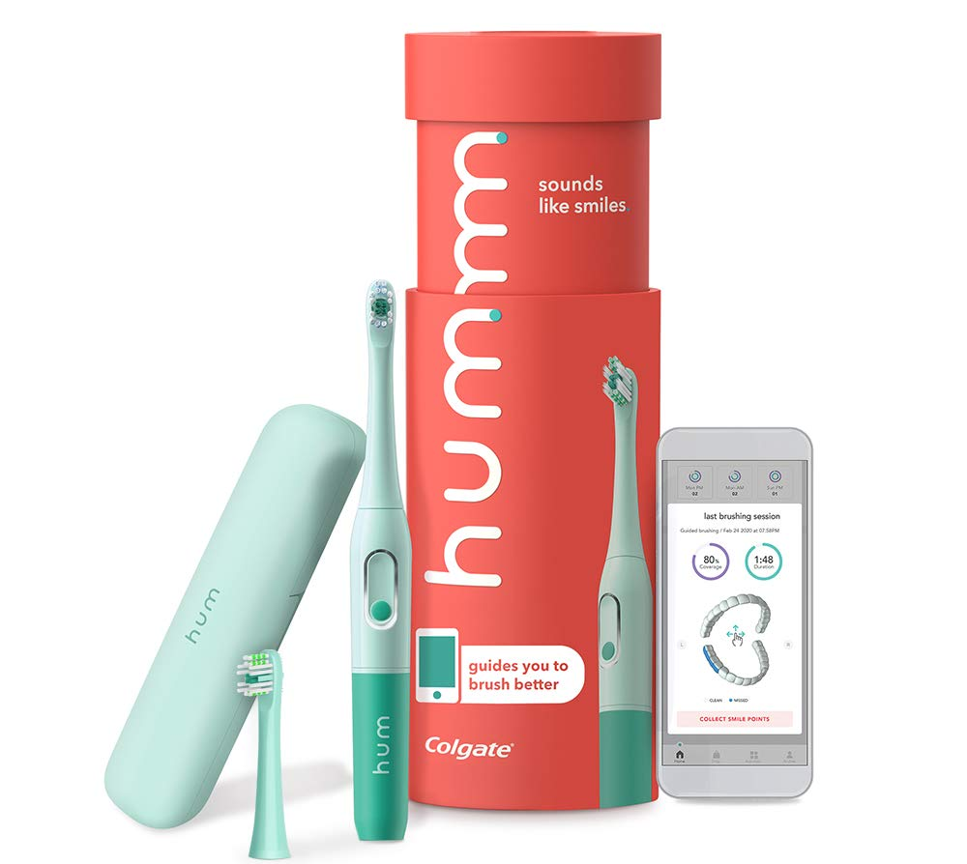

Various Toothbrushing Options

Slide 21
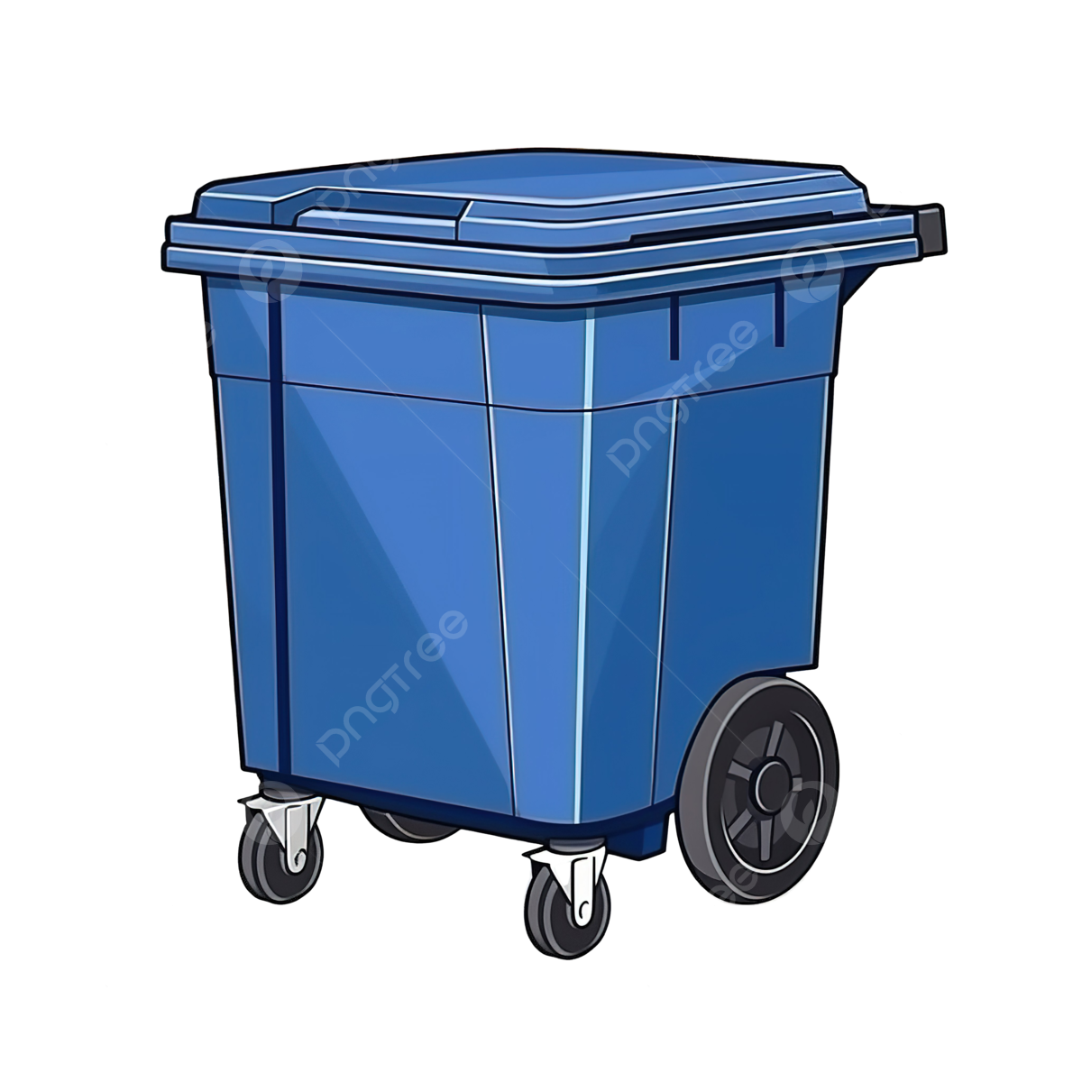
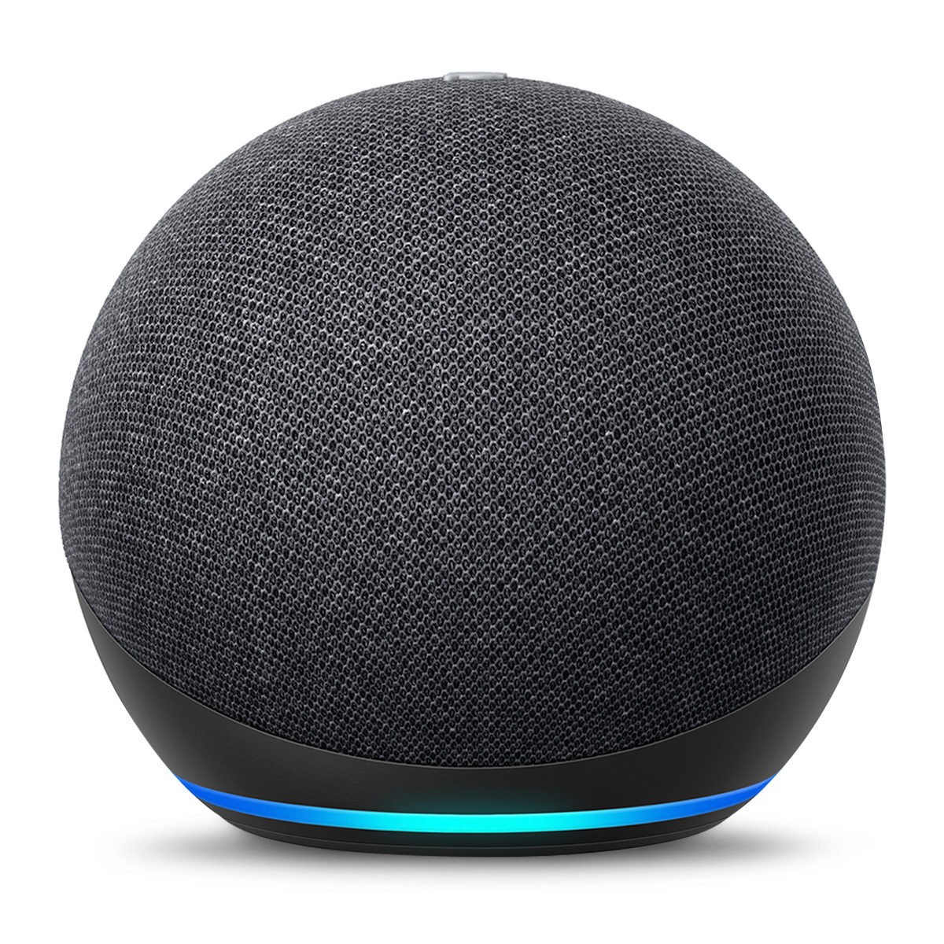
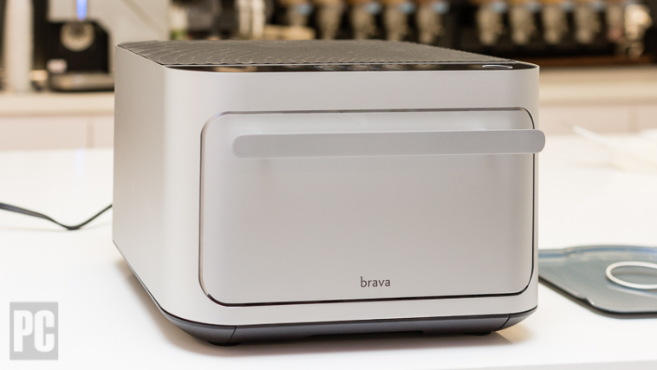
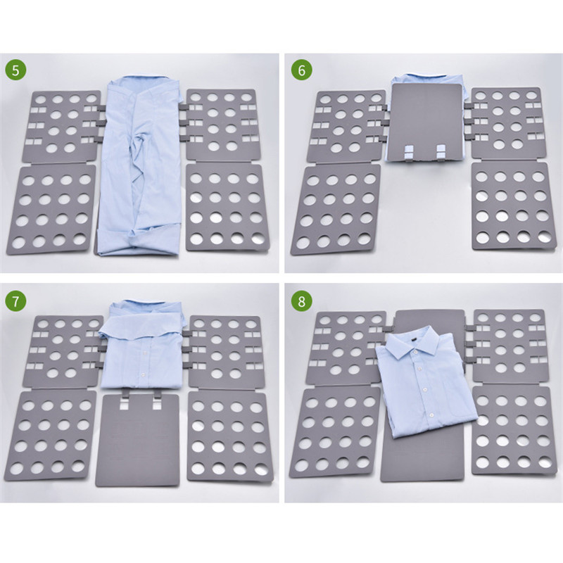
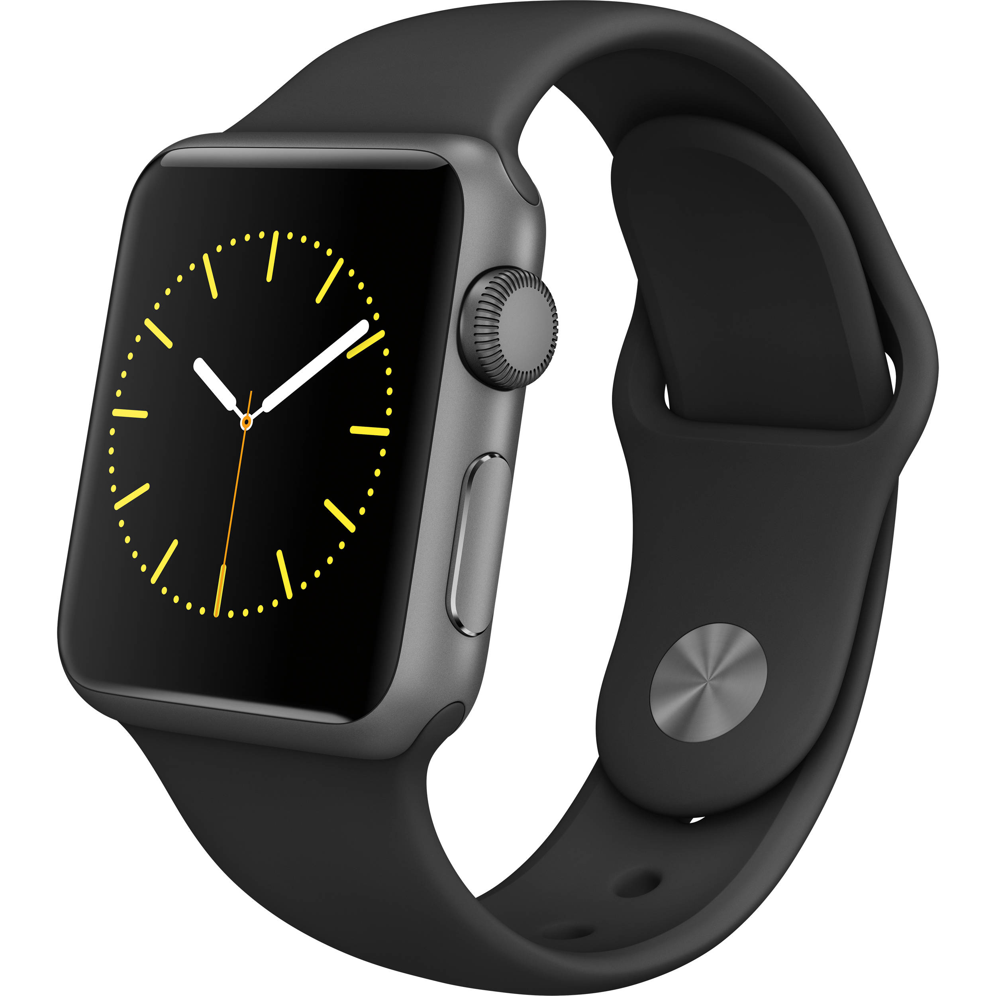
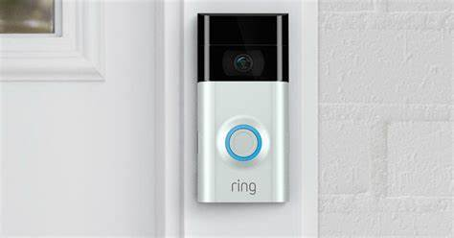
Simple integration of AT to help everyone

Slide 22
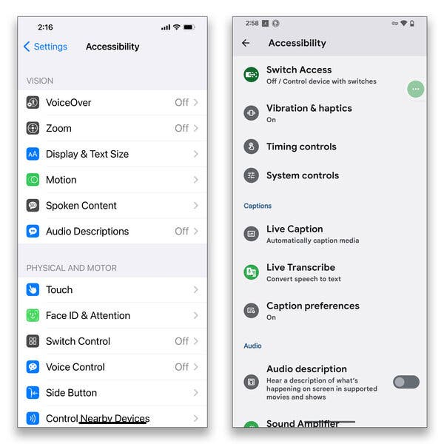
Smart Phone Accessibility
ADDITIONAL UNIVERSAL AT
SMART
PHONE ACCESSIBILITY
AND APPLICATIONS
Display Text Size
Motion Alerts
Audio Descriptions
Switch Access
Live Transcribe
Voice Over/Voice Control

Slide 23

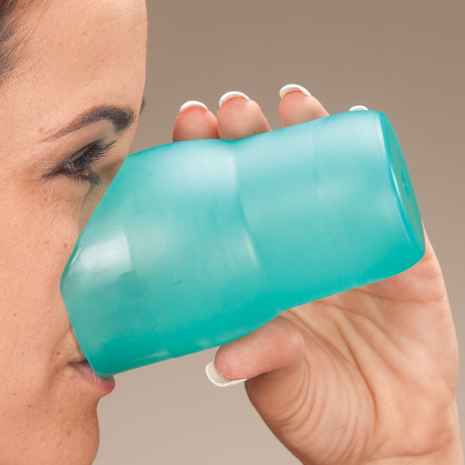
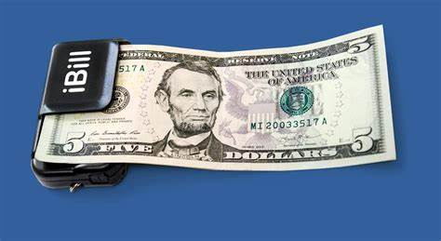
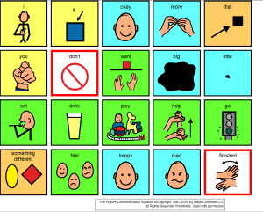
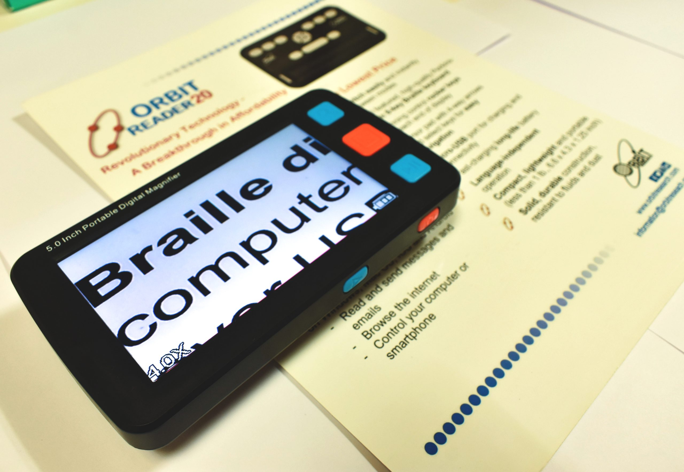
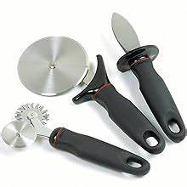
Some Low Tech/No Tech Options
Supportive Technology

Slide 24
Impact Stories
RL was provided with Voiceitt, a first-of-its-kind speech recognition tool that uses AI technology to learn his unique speech patterns and translate his unintelligible speech into recognizable speech. This allows him to repair communication breakdowns with communication partners who do not understand his speech. This provides RL with a sense of independence, as he no longer needs to rely on his mom to translate for him.
Additionally, Vocieitt's integration with ChatGPT gives him the ability to ask questions relative to his favorite celebrities and get detailed answers, something he could not do using the regular speech-to-text option on search engines as a result of his unintelligible speech.

Slide 25
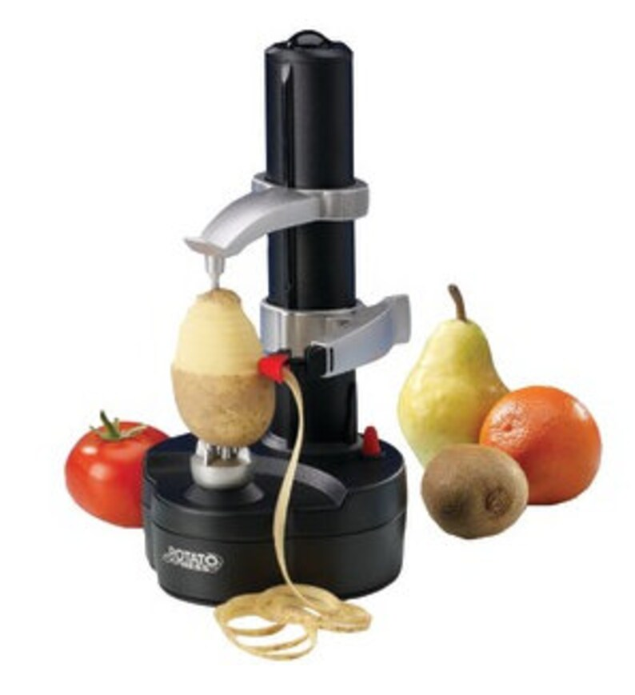

Impact Stories
RS is full of great ideas and is an enthusiastic learner. He expressed wanting to help out his mother with cooking and participate more in games. We got a switch-adapted vegetable peeler that peels potatoes rapidly with the push of a button. .
RS and his family joked that he always has dirty glasses and asked if there is any AT that could help with that, expecting there not to be. But we found a glasses cleaner that involves immersing the glasses in solution and then pushing a button, which is much easier for RS than using a cloth. I love when we can find creative solutions, especially for an area that someone feels is outside the realm of AT.

Slide 26
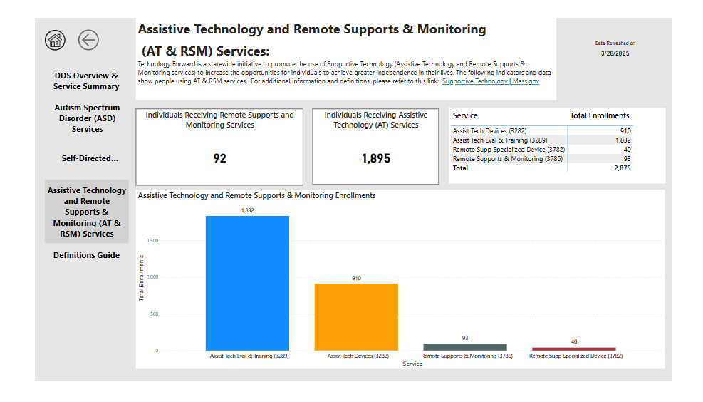
Data Analytics

Slide 27
PROVIDERS
SUPPORTIVE TECHNOLOGY
There are currently 14 Assistive Technology Providers across the state. Not all providers serve every region, but each region has multiple providers. Individuals are encouraged to choose the provider they would like to work with.
There are currently 10 Remote Supports and Monitoring Providers across the state. Subcontracts exist within each provider with Safe in Home, Night Owl and Simply Home to provide Remote Supports and Monitoring options to individuals.
There are several projects through EOHHS funding including a Massachusetts based call center using the Simply Home and Boundary Care platforms.

Slide 28
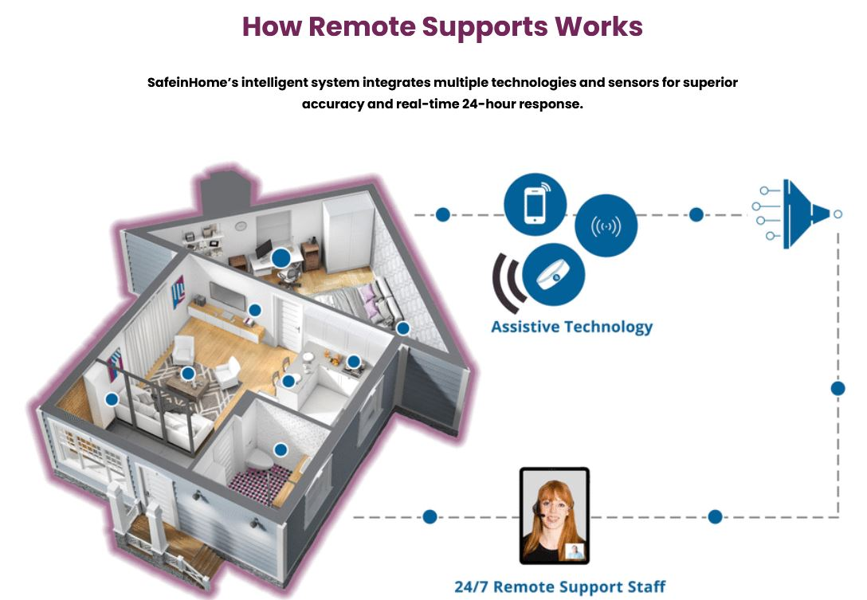
Remote Supports & Monitoring
Safe in home
Simply home
Boundary Care
Night Owl

Slide 29
What is Remote Supports and Monitoring?
SUPPORTIVE TECHNOLOGY
The use of two-way, real-time technology, such as a tablet, to provide support and/or supervision to individuals by a staff at a remote location.
Communication and non-invasive monitoring technologies to assist individuals to attain or maintain independence in their homes and communities.
Platforms integrate information from sensors, Ring doorbells, wearables and other technology to give information to the call centers.
Systems are personalized based on individualized goals, concerns and outcomes to determine when the person needs assistance.

Slide 30
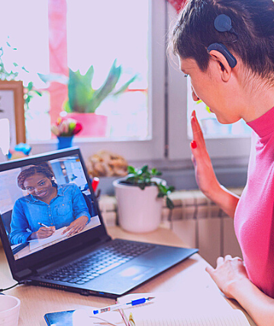
FEATURES AND OPTIONS of REMOTE SUPPORTS & MONITORING
SUPPORTIVE TECHNOLOGY
Individual receives personal prompts throughout the day, such as when it is time to get up and get dressed, or to take medication, etc.
Alert if there is no noted activity on sensors for a given amount of time.
There is always an identified paid support to respond within 30 minutes
Notifications to a caregiver is emergency responses are activated
Can have services for specified times or for 24 hours a day.
The individual may also have a Personal Emergency Response System (PERS) as part of their plan.

Slide 31

Personal Emergency Response System (PERS)
Enables an individual to secure help if an emergency using an electronic device.
An electronic device(s) that is programmed to signal a response center once the help button is activated and/or sensor triggered.
The emergency response activator must be able to be activated by breath, by touch or some other means and must be usable by any person who may be visually or hearing impaired or physically disabled.

Slide 32

Examples of Assistive Technology
Use with Remote Supports & Monitoring
Electronic motion sensor devices
Door alarms
Sensors that detect that a stove has been left on
Telephones mods large or picture buttons/flashing lights
Device on wheelchair or walker to send an alert if the individual falls
Bracelet that detects seizure activity
Devices that enhance images for people with low vision
Voice activation of lights, appliances, doors, etc
Hand-held computer devices

Slide 33
Levels of RSM
SUPPORTIVE TECHNOLOGY
Level A – RSM services that require two-way video/audio feed for staff to provide support real-time scheduled check-ins and supports by remote caregiver, on-demand support initiated by the individual. This level of support provides in-person backup support. This level provides up to 15 hours per week of scheduled, on-demand, or individual-initiated remote supports.
Level B – Same as Level A, plus: The provision of an enhanced personal emergency response system (PERS) which requires sensors or other safety mechanisms to send an alert to the remote monitoring center identifying an emergency, per an individual’s plan, to initiate appropriate emergency response or in-person backup support. This level provides 16-25 hours per week of scheduled, on-demand, or individual-initiated remote supports.
Level C – Same as Level A and B, This level provides 26 or more hours per week of scheduled, on-demand, or individual-initiated remote supports.

Slide 34
Putting it all together
South Shore Support Services has outfitted an entire “smart apartment” with a calm living space and cutting-edge Assistive Technology (AT) in charming Cohasset Village. The goal of the apartment is to help individuals with complex needs learn basic independent living skills in a safe and supported environment. The apartment offers 24-hr staff and various AT to assist with apartment duties.
Through the use of AT and RSM supports, individuals are able to trial and train on various AT to improve their independence through a Respite Model.
23 have stayed, 3 pending
3 moved to their own apartments

Slide 35
Addressing needs and training in multiple life domains
Supportive Technology
Individuals work on: meal planning, meal prep, laundry, activities of daily living, community skills, and general housekeeping and safety skills with access to 24-hour staffing.
Safety and AT Features include:
Simply Home Monitoring and Communication device
Ring Doorbell Monitoring for entry to/from the apartment
Apple Airtag when in the community
Fire Detection/Stoppers in the stove area
Auto shut off when stove is left on unattended
Auto shut off for shower if water becomes too hot
Kitchen assistive technology tools
Bathroom bidet to support hygiene
24hr support both remote and in-person depending on individual preference and abilities

Slide 36
RSM Impact Story
NL is a young woman who lives in her own apartment. When she was having trouble remembering to get everything ready for work, completing her morning routine on time and calling her cab for a timely arrival to her job, her sisters would call several times a day to prompt her through the process. Since NL is the oldest sibling, the role her younger sisters had to take put a tremendous strain on their relationships. NL started receiving RSM and had full input into her support plan. She receives a call after she arrives home from work with reminders to wash her uniform if needed and make her lunch. In the morning, she receives a wakeup call with reminders about her routine before work. She then receives a second call to be sure she has called the cab. NL is thriving with these supports and her boss has indicated it has resolved any issues. Her sisters also report they have gone back to the role of sisters and their relationship has improved.

Slide 37
What’s Next? EOHHS Grant
Increased Remote Support Capabilities
Medication Management Systems
Biometric Health Monitoring to address Fatal 5
Automated documentation
Notes:
Nonverbal/ major health inequities

Slide 38
THE FUTURE with SUPPORTIVE TECHNOLOGY
SUPPORTIVE TECHNOLOGY
Supportive Technology is a key component as we look to greater independence and success for the individuals' we serve in their homes and community.
Through embracing AT and RSM, DDS eligible individuals engage in more independent and functional lives, whether it is through communication, health and safety, employment or activities of daily living. Individuals are discovering new potentials through this service.
In addition, the use of AT can assist our work force situation through supporting workers in their jobs and by increasing independence for those we serve.

Slide 39
Questions

